Slide 1
Mueller Laboratory Renovation
by
Mark Jackson

Slide 2
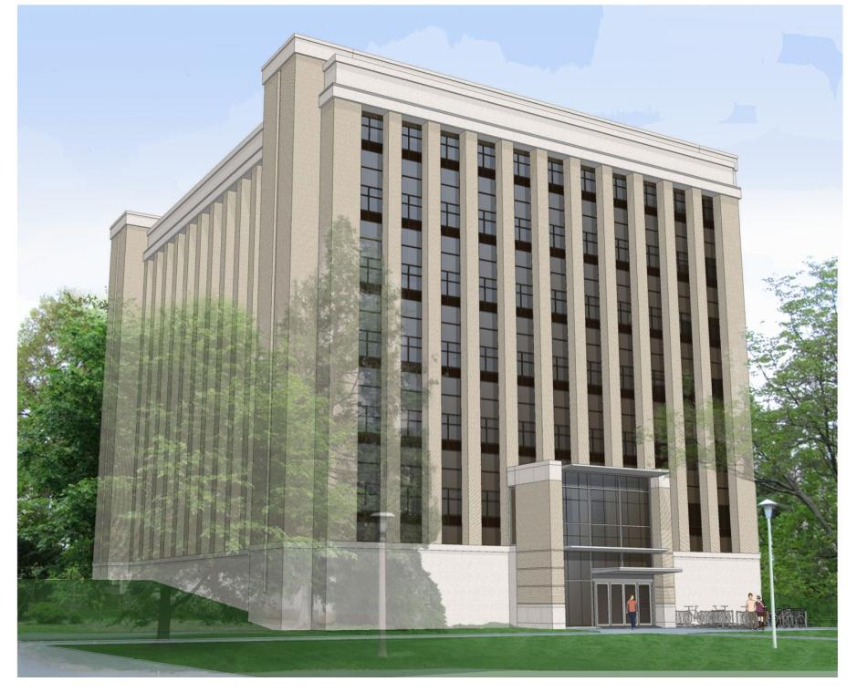
Client Information
Penn State University
Renovation Details:
  Replace outdated HVAC, electrical systems
  Maintain building envelope
  Renovate interior finishes
  Fire safety, accessibility, elevators
Building to remain partially occupied
High pedestrian traffic area around building
Minimal interruption to school years

Slide 3



Project Delivery
Owner
OPP Project Manager: Robert Bloom
Designer
Jim Radock
CM at Risk
Scot Mull

Slide 4
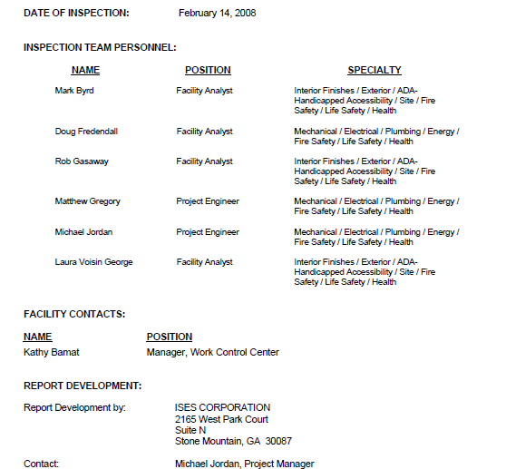
Project Schedule
Building Inspection Winter 2008
Design bids: Spring 2012
Construction bids: Fall 2013
Construction
  Start May 2014
  Completion August 2015
  Renovation, not new construction
Waiting on schedule details from CM

Slide 5
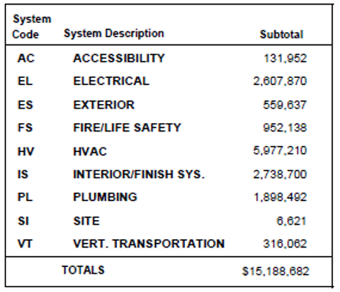
Project Cost Evaluation
Square footage: 75,482ft²
Cost/SF for College Laboratory, new construction: $206.70 (from RS Means 2014)
Cost estimate: $15,602,130
New construction cost comparable to renovated cost

Slide 6
Building Systems Summary
Electrical distribution system
Building envelope
  Replace roof
  Repoint bricks
Fire safety-sprinkler system
HVAC system-air handlers and ducts
Interior finishes-paint, hardware
Plumbing-campus chilled water
Elevator

Slide 7
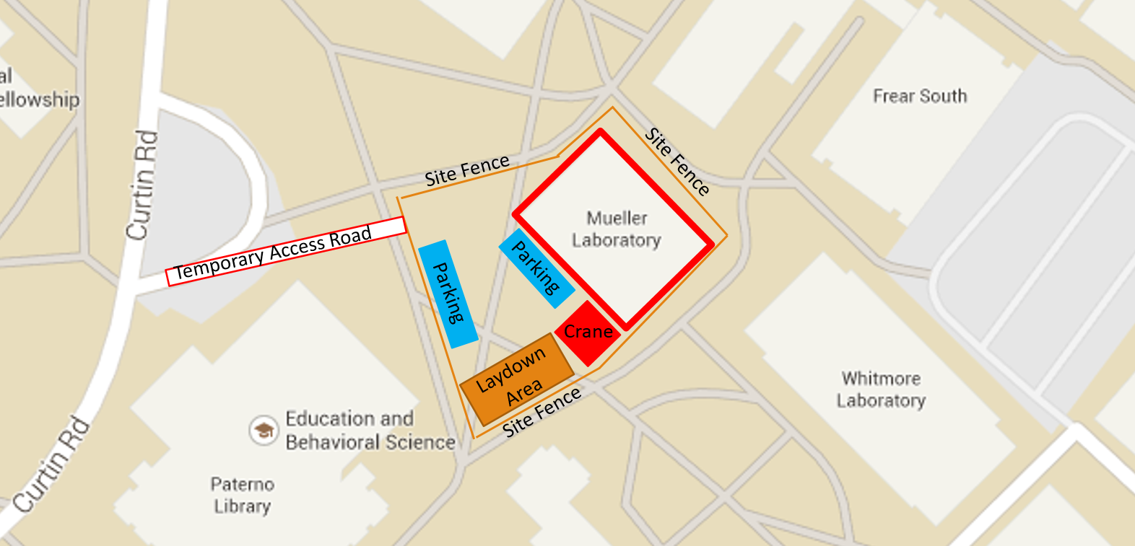
Existing Conditions/Site Plan

Slide 8
Staffing
Barton Malow
  Scott Mull, project manager
  Jeremy Duckott, Document Distributions
Waiting on futher staffing details

Slide 9
Questions asked
What changes could be made to the scope or schedule to ensure the project finishes on time?
Are there any sustainability components of the design?

